Slide 1
Meeting the needs of our population to improve health outcomes and equity
NZNO Midlands Professional forum November 2022
Facilitator: Chris Baker, Nurse Consultant Cultural workforce development
Te whatu ora Waikato district

Slide 2
“When people move into the nursing reality and become labelled as patients or clients, there are powerful attempts to reshape them to conform to the culture of nursing, often with a great deal of success because nurses are very powerful. Nursing culture is upheld by specialised knowledge. People need what we have to offer and they cannot readily obtain it elsewhere”
Ramsden, I. (1990). Cultural Safety in Nursing Education in Aotearoa https://trc.org.nz/sites/trc.org.nz/files/digital%20library/Cultural%20safety%20in%20nursing%20education%20in%20Aotearoa.pdf

Slide 3
Overview of presentation
Revisit cultural safety
Reflection on who you are and how this influences your practice
Understanding unconscious bias in health care
Equity vs Equality
Improving health outcomes and equity
What do our patients say
Nursing contribution to improving equity
Health reforms 2022

Slide 4
Definition of Cultural Safety
The effective nursing practice of a person or family from another culture, and is determined by that person or family. Culture includes, but is not restricted to, age or generation; gender; sexual orientation; occupation and socioeconomic status; ethnic origin or migrant experience; religious or spiritual belief; and disability.
The nurse delivering the nursing service will have undertaken a process of reflection on his or her personal cultural identity and will recognise the impact that his or her personal culture has on his or her professional practice. Unsafe cultural practice comprises any action which diminishes, demeans or disempowers the cultural identity and well being of an individual.

Slide 5

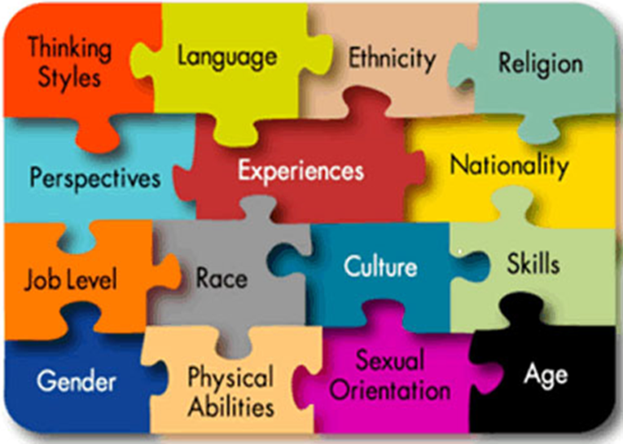
Cultural safety aims to improve health status of New Zealanders and applies to all relationships.
Cultural safety aims to enhance the delivery of health and disability services through a culturally safe nursing workforce.
Cultural safety is broad in its application.
Cultural safety has a close focus on: understanding the impact of a nurse as a bearer of his/her own culture, history, attitudes and life experiences and the response other people make to these factors; balancing power relationships and understanding power imbalances.
Nursing Council of New Zealand. (2011). Guidelines for Cultural Safety, the Treaty of Waitangi and Māori Health in Nursing Education and Practice. Author.

Slide 6

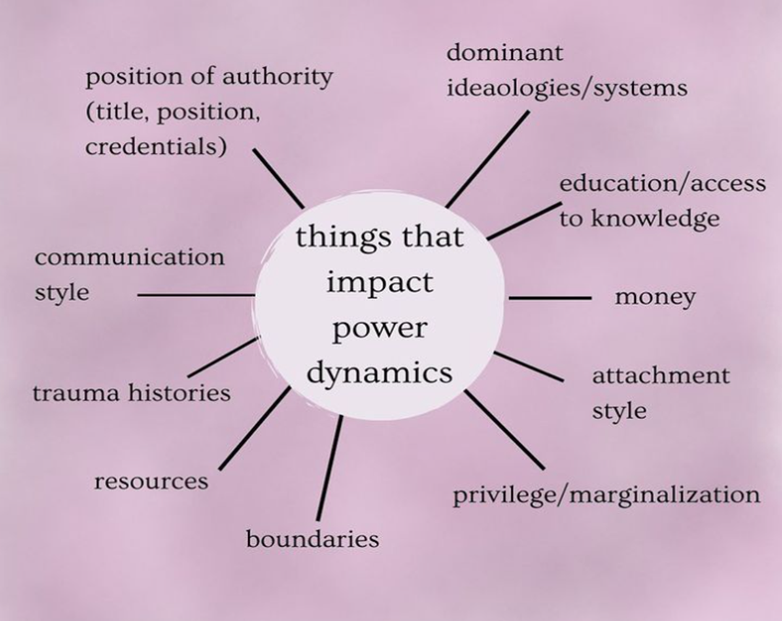


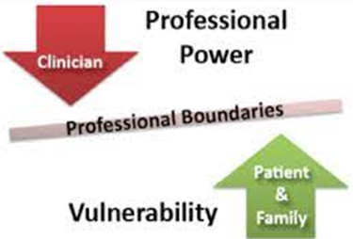
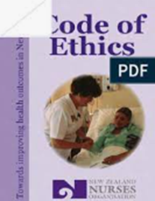

Slide 7
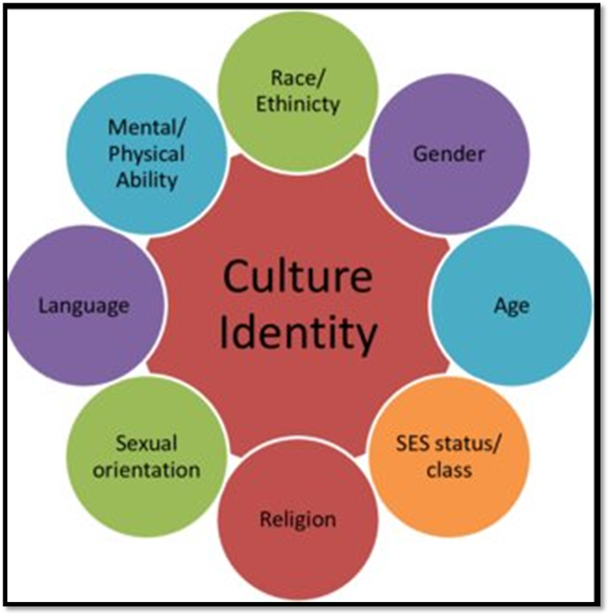
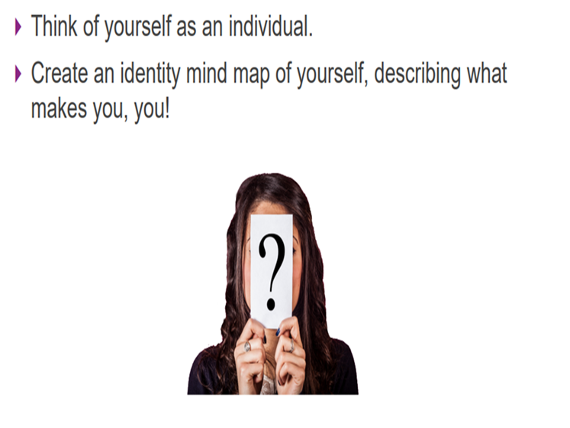
Who are you?

Slide 8
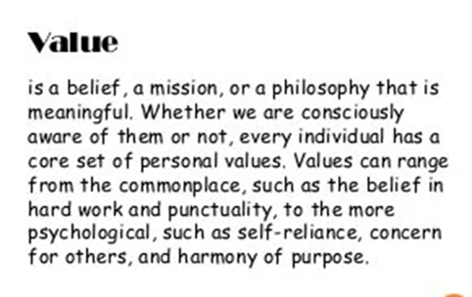
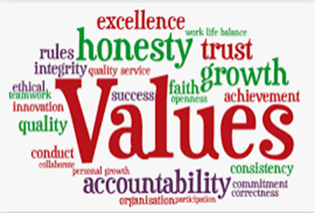
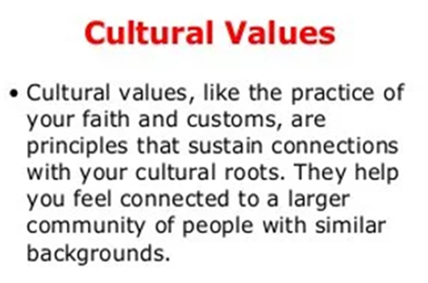

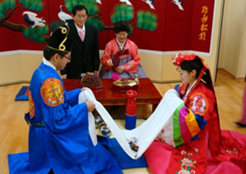


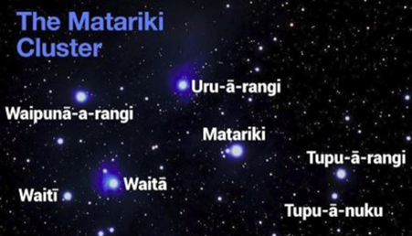
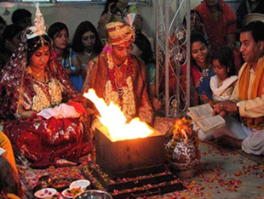
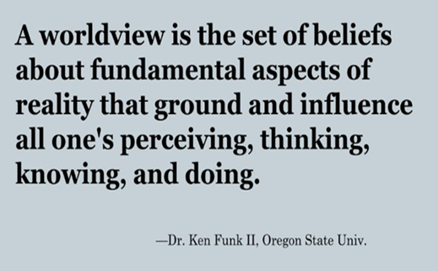


What are your values?
Where do they come from?
What are your customs and traditions?
What is your worldview?

Slide 9
Self awareness unconscious bias
To understand others, we must first understand and acknowledge our own values, beliefs and biases and how these may influence our engagement and communication with others who are from diverse cultural backgrounds.
If we continuously try to interpret another’s behaviour using our own culture as a reference for what is normal, misunderstanding will occur.
Social stereotypes about certain groups of people that individuals form outside their own conscious awareness
Prejudice or unsupported judgements in favour of or against person or group as compared in another way that is considered unfair
Result of unconscious bias means certain people benefit and other people are penalised
Can cause unintentional discrimination and result in poor decision making
https://www.hqsc.govt.nz/resources/resource-library/learning-and-education-modules-on-understanding-bias-in-health-care/
https://www.youtube.com/watch?v=gEZB-9igpDo

Slide 10
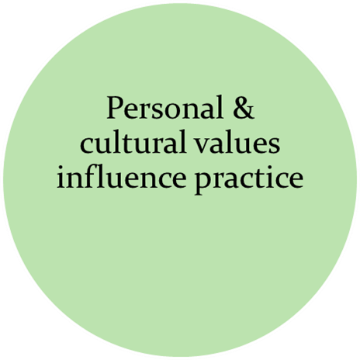
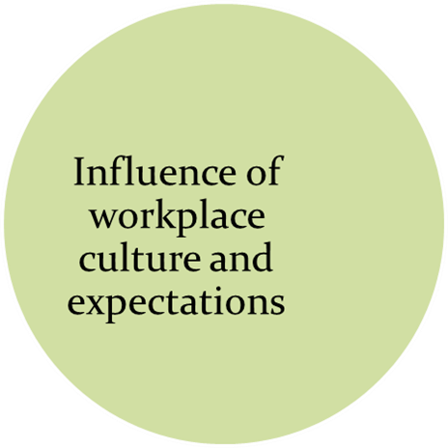
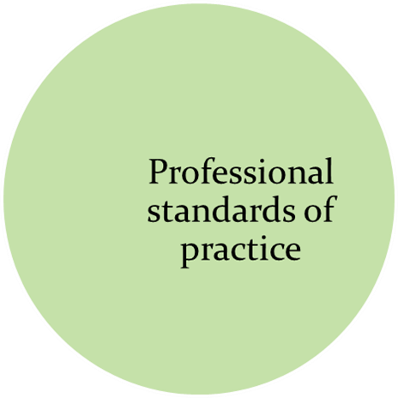
Potential for tension as result of personal and cultural values

Slide 11
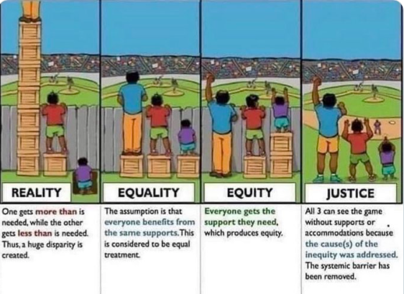

Slide 12
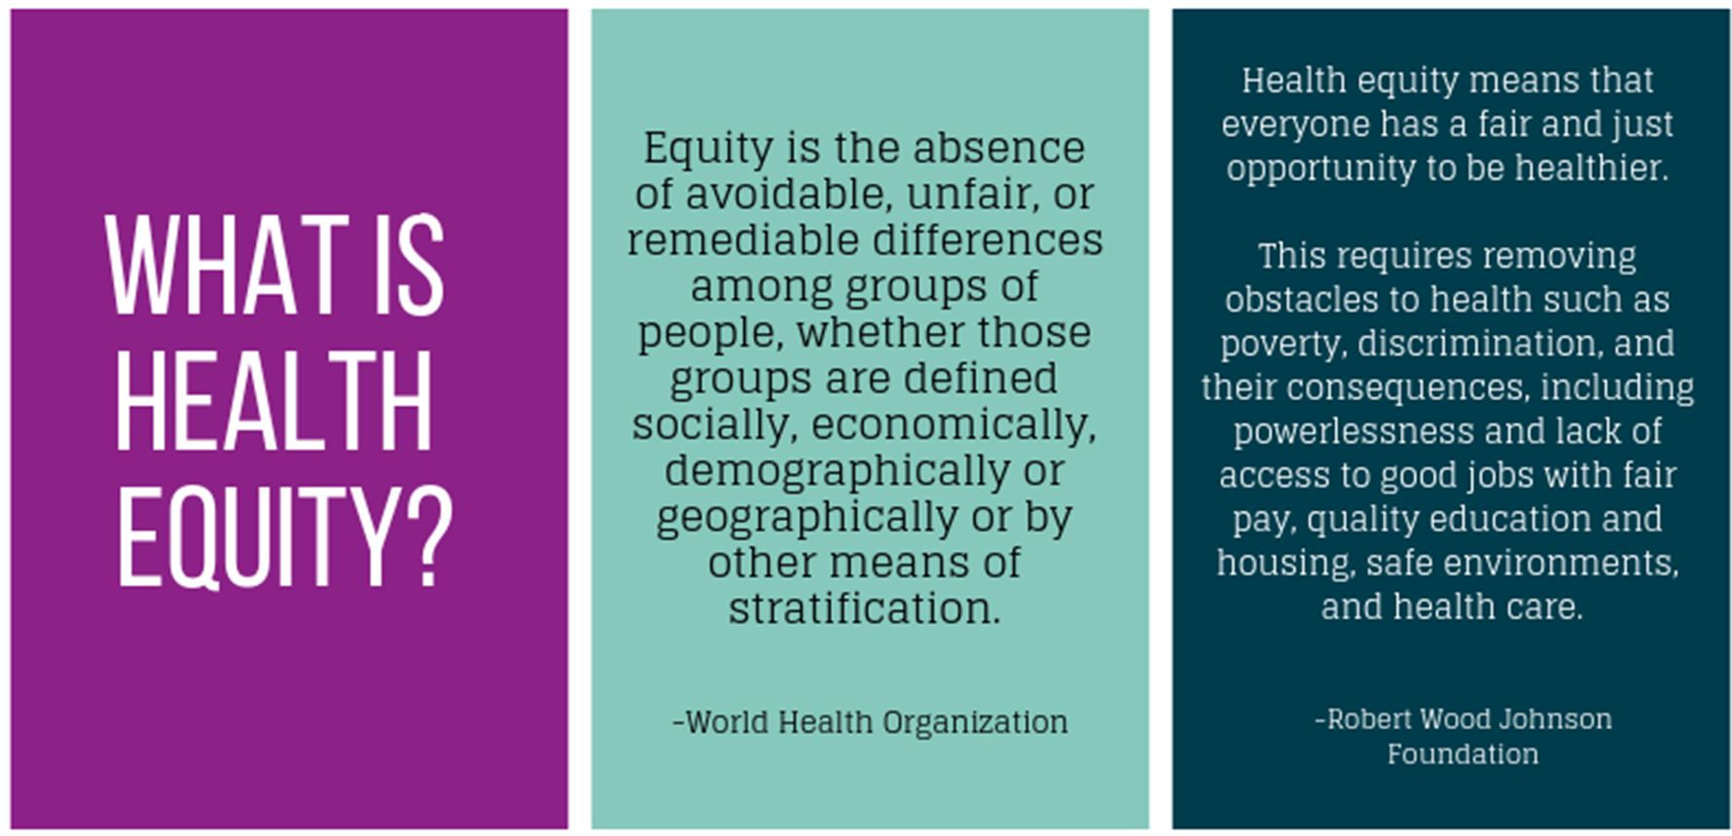
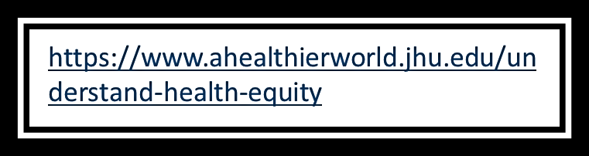

Slide 13
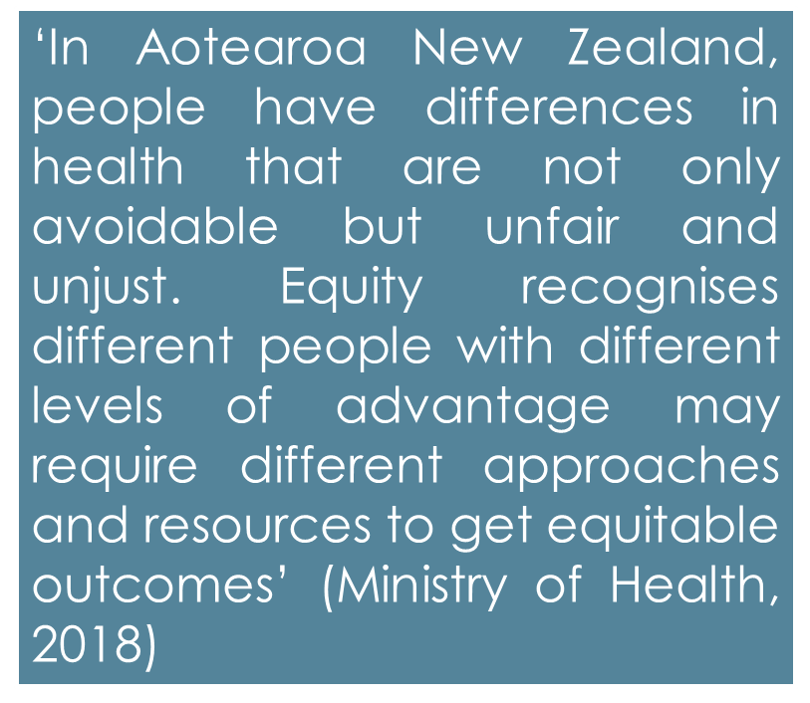
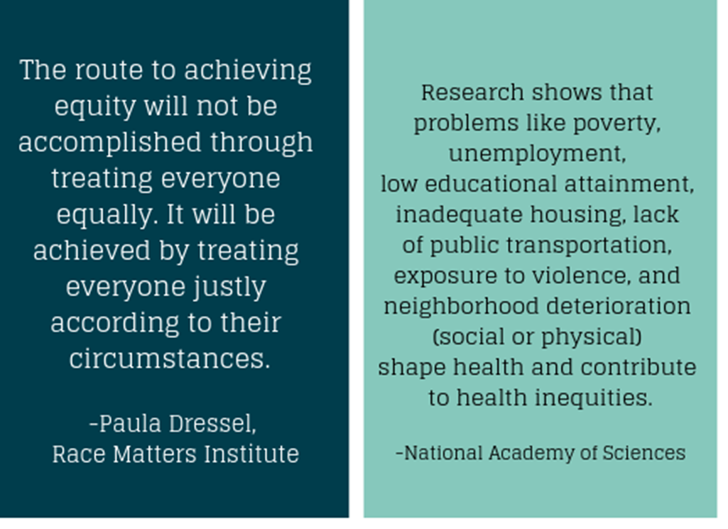
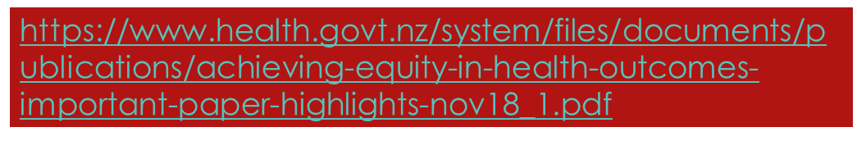


Slide 14

Improving health outcomes and health equity
Nurses and healthcare professionals alike have the gifted opportunity to truly change attitudes toward Māori health and move forward in adopting culturally appropriate care practices. More specifically the nursing workforce provides 80% of direct patient care, thus are in a unique position to be the forefront of change in reducing health disparities experienced by Māori. Incorporating cultural safety, patient advocacy, and Māori-centred models of care will support nurses in adopting a new approach toward improving Māori health outcomes overall (Theunissen, 2011).
https://www.youtube.com/watch?v=6xKYqOn2Uo8
Notes:
Contemp Nurse
. 2011 Oct;39(2):281-6.
doi: 10.5172/conu.2011.281.
The nurse's role in improving health disparities experienced by the indigenous Māori of New Zealand
Katherine Evelyn Theunissen ¹
Affiliations expand
PMID: 22551439
DOI: 10.5172/conu.2011.281
Abstract
Many countries across the globe experience disparities in health between their indigenous and non-indigenous people. The indigenous Māori of New Zealand are the most marginalized and deprived ethnic group with the poorest health status overall. Factors including the historical British colonization, institutional discrimination, healthcare workforce bias and the personal attitudes and beliefs of Māori significantly contribute to disparities, differential access and receipt of quality health services. Māori experience more barriers towards accessing health services and as a result achieve poorer health outcomes. Contradicting translations of Te Tiriti o Waitangi have created much debate regarding social rights as interpreted by Oritetanga (equal British citizenship rights) and whether or not Māori are entitled to equal opportunities or equal outcomes. Inconsistent consideration of Māori culture in the New Zealand health system and social policy greatly contributes to the current health disparities. Nurses and healthcare professionals alike have the gifted opportunity to truly change attitudes toward Māori health and move forward in adopting culturally appropriate care practices. More specifically the nursing workforce provides 80% of direct patient care, thus are in a unique position to be the forefront of change in reducing health disparities experienced by Māori. Incorporating cultural safety, patient advocacy, and Māori-centred models of care will support nurses in adopting a new approach toward improving Māori health outcomes overall.
Similar articles

Slide 15

Kolini shares her story of battling with mental health issues. The video beautifully shows her transition from acute care to community care with the support of Te Oranganui, a local Māori health provider.
https://www.hqsc.govt.nz/resources/resource-library/pono-consumer-story-kolini-baker/
Barriers and enablers to early diagnosis of lung cancer were categorised into three key themes: GP relationship and position in the community, health literacy and pathways to diagnosis.
Cassim, S., Kidd, J., Rolleston, A., Keenan, R., Aitken, D., Firth, M., Middleton, K., Chepulis, L., Wong, J., Hokowhitu, B. and Lawrenson, R. (2021), Hā Ora: Barriers and enablers to early diagnosis of lung cancer in primary healthcare for Māori communities. Eur J Cancer Care, 30: e13380. https://doi.org/10.1111/ecc.13380
For many Māori, the existing public health system is experienced as hostile and alienating. Whānau members provide support to mitigate this, but it comes as a cost to whānau.
Graham, R. and Masters-Awatere, B. (2020), Experiences of Māori of Aotearoa New Zealand's public health system: a systematic review of two decades of published qualitative research. Australian and New Zealand Journal of Public Health, 44: 193-200. https://doi.org/10.1111/1753-6405.12971

Slide 16
How can nurses contribute to improving health equity?

Slide 17

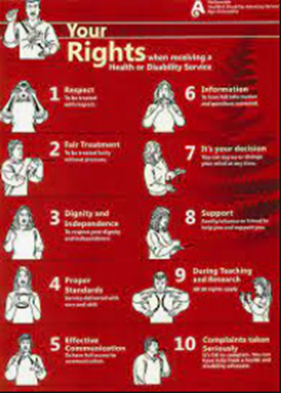

Slide 18
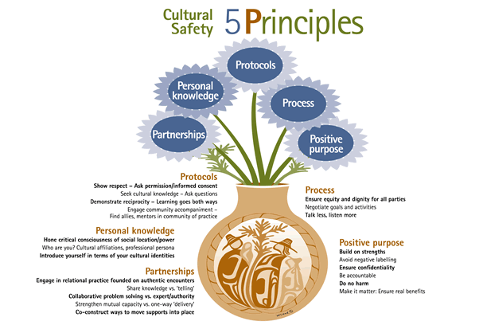



https://nursinganswers.net/essays/causes-maori-health-inequalities-policies-5134.php

Slide 19

Improving health literacy
Health literacy is the foundation for consumer and whānau engagement. It is being able to obtain, understand and use basic health information to navigate health services and make appropriate health decisions. The health care professional is responsible for presenting health information in a way that a person can understand.’ (Brach et al 2012).
Brach C, Keller D, Hernandez LM, et al. 2012. Ten Attributes of Health Literate Health Care Organizations. Institute of Medicine. URL: gahealthliteracy.org/wp-content/uploads/2014/07/BPH_Ten_HLit_Attributes.pdf

Slide 20
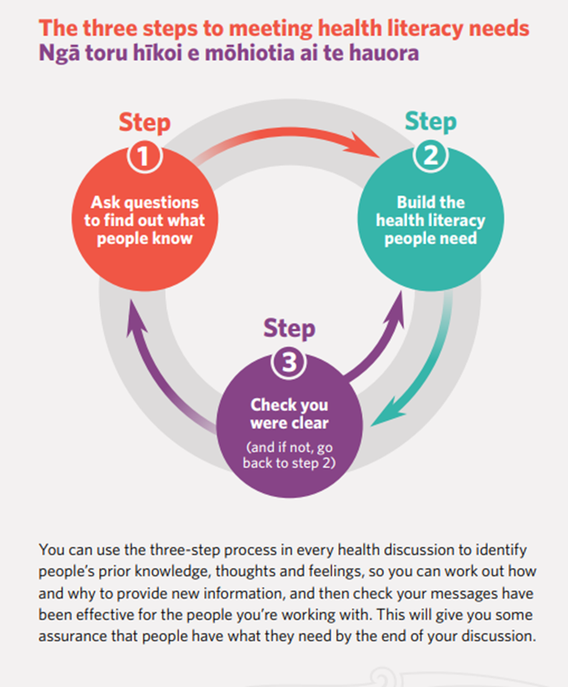
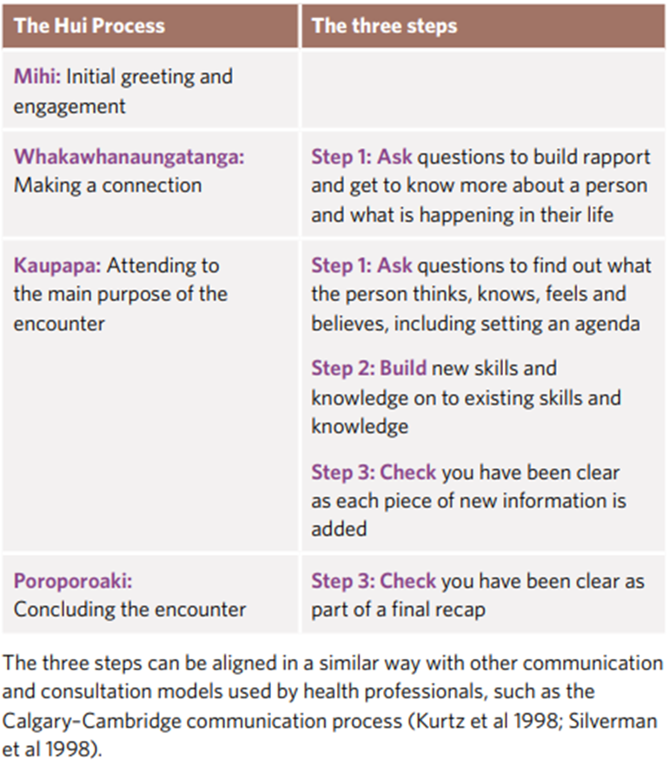

Slide 21
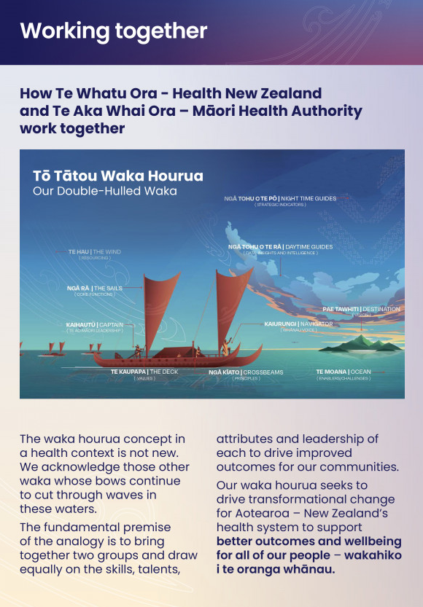
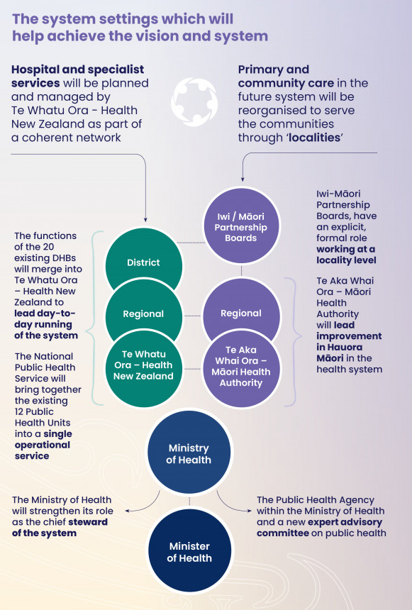
HEALTH SECTOR REFORMS 2022

Slide 22
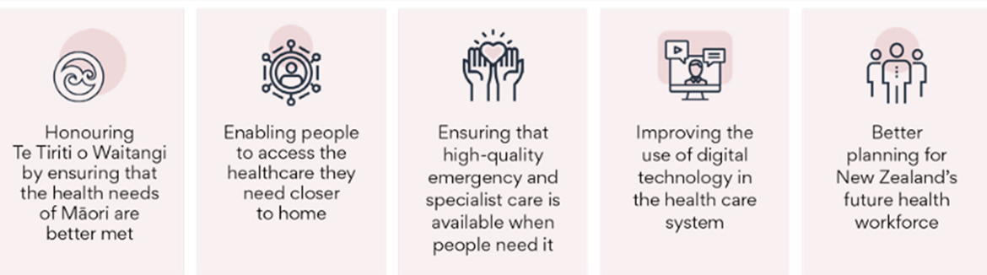

Slide 23
“Nursing in New Zealand has moved with this relationship with the indigenous people and is at the forefront of real change. Change has been naïve, painful, misunderstood and resisted. It has also been exciting and at times triumphant, and is absolutely inevitable. It is the right time for this idea. This is part of the process toward the maturing of the new societies which make up the recent story of the islands which some call New Zealand and some call Aotearoa.”
Ramsden, I. (1990). Cultural Safety in Nursing Education in Aotearoa https://trc.org.nz/sites/trc.org.nz/files/digital%20library/Cultural%20safety%20in%20nursing%20education%20in%20Aotearoa.pdf

