Slide 1


“I can’t, I’m not xxxx enough…but with support”
Breaking through the barriers
Nurse Managers Conference 2017
Jane MacGeorge: Manager, Nursing and Professional Services
Notes:
Tēnā koutou katoua
thank you for the invitation to speak –I think its fantastic you have a conference like this. You are a critical workforce of leaders throughout the health system – often called the squeezed middle. Support of nurse managers and leaders is key to ensuring there are safe practice environments and nurses are supported and developed. I have seen many examples of best practice quality patient environments led by empowered managers and leaders with well engaged and happy staff.
Sarah gave me some background to work you have been doing as part of your section. the notion that many nurse leaders often have self doubt – I'm not good enough …… etc I pondered on this and wonder if it is a gender issue too. There is research that shows men are much more likely to apply for senior roles even if they don’t have all the experience where women feel they need to have most of the experience to apply. And when you do get the job there are often feelings of being an imposter – “the imposter syndrome” being a NM is a huge responsibility as you are accountable for your services, teams and organisations success.
I have always been a strong advocate for supporting and coaching the development of nurses into senior roles both professional and managerial. Its important nurses are coached and mentored as they take on new roles and responsibilities. I often support NP candidates and meet monthly until they are endorsed. I rarely look at their portfolio but am their champion to keep them on track and push them across the line!
I would like to talk about the work we have started at NZNO after feedback from nurse managers and leaders around the county. Our strategy for nursing will be out for consultation soon too so please pay close attention to that as it will support leadership capacity and capability for nursing.

Slide 2
My Path…
1980
1995
2000
2006
Practice
RN
Education
Professional
Nurse Consultant
Management
Nurse Educator
Lecturer Postgraduate
Post basic courses
Specialities
Director of Nursing
General management - community nursing
Director clinical services
Manager, Nursing & Professional Services
Manager, Clinical Advisory
Masters
Private Sector
NGO
Charity
Professional/industrial organisation
DHB
DHB
Private Sector
DHB
University
Notes:
First, I will begin by sharing with you my path over the last 37 years as a RN and why I am so interested in this area of leadership – however I am always learning, its important to take those experiences and learnings into new roles and organisations – management and leadership competencies are transferrable skills!
My early years were very much in acute settings (ED/ICU) in DHB’s – highly structured, regulated complex organisations. I had opportunities to discover my own leadership through mentoring, coordinating shifts etc. I felt a growing sense of frustration having ideas but not being heard or someone else having that idea later!
I am convinced that it is all about the leadership – while organisation culture and structure differ – it is about relationships with people and how to deal with the hard stuff and reinforce the good stuff.
Over time you start to understand where your strengths are and what you are most interested in and what you leave for those who are more interested. I love strategy, service development and innovation, money (budgets)! Developing a case for change for resources – budgets, business cases. I like to find tools and resources to empower and support the work of leaders. I love working with people who are expert in quality, detail, analysis, policy – you will be getting the picture! I can live with the status quo as long as it is productive and adding value to the vision and goals of the organisation, otherwise I am disruptive or look for ways of strengthening teams and services to achieve results – Its important to stop and reflect - “are we accomplishing the collective goals we've set? to make a difference and to whom? We have limited resources and can often be pushed into being reactive than being proactive and having time to plan.
Like many of you, I had strong role models and mentors. People who saw something in me and encouraged me (pushed me). Gave me opportunities for growth and development. My career path was fairly linear up to about 2004 when a senior nursing restructuring made me look at options that took me outside of the DHB into a less regulated and structured environment. Again, I was pushed into general management “working in a private organisation was like going to a business school.” I am really grateful I had the opportunity to learn about contracting, budgets, BC, RFP’s as that has supported my subsequent management roles to get a “yes” – or mount an evidenced based argument for resources, capability, capacity building. Working across organisations I have had to understand what gets the best out of people but also be alert to bullying behaviour and interpersonal conflict that can make the workplace an unsafe and unpleasant environment.
While I continued to move more into the third sector, community and non-govt organisations my professional and education background have supported my leadership roles as part of my tool kit to support teams and organisational development.
However what remains constant in these roles is how to navigate relationships and influence those around you so you can get the job done!

Slide 3
The Environment we live and work in…
Notes:
I want to touch on the environments we are working in today and why many of you will find it is more chaotic and complex than ever before – why you feel you cant get control and change is constant – it is here to stay.
We are communicating with more people than ever before and through so many different channels – information is coming at us constantly – we have information overload!
People expect more but also want more from how they work and engage in the workplace. I'm going to talk about the workplace and complexity throughout this presentation as its important for how we function as leaders

Slide 4
Notes:
If you wondered why you spend most of your day communicating with a number of people, or trying to track down the right person to talk to then this will help explain why some days feel chaotic and out of control. We are not functioning in linear structures or hierarchy anymore, our organisations have a number of matrix’s some visible and some not. Some organisational matrix of communication or teams have developed informally so people can communicate more effectively and get work done. Interpersonal communication and relationships become an important part of how you work across an organisation or system.
Many of you here will have a number of staff reporting to you. This will vary across organisations and structures – its important you get the functions of reporting lines figured out so you have the right span of control to manage the service but trust others responsible for various aspects of staff support and service delivery.

Slide 5
Complexity Science in Healthcare (Braithwaite et al, 2017)
Three time points of collaboration among cancer clinicians and researchers
Australian Institute of health innovation. Macquarie University.
Notes:
There is a whole area around Complexity science - the more you accept uncertainty the more adaptive you will be in your role. This is easy to say when your day feels out of control.
How do we support managers to be highly adaptive – often staff will say “when is change going to stop”
It is hard to challenge old ways of thinking about healthcare systems and working in them when you are asked to make changes within existing structures and processes. Those working with complexity science are looking at new paradigms of understanding in conceptualising healthcare and how to move forward in unpredictable environments. This work done by Braithwaite and colleagues is worth a read.

Slide 6
The Squeezed Middle supporting managers in healthcare
(The point of care foundation – www.pointofcarefoundation.org.uk)
Improving the way we are cared for – delivers highest quality care
Staff need practical and emotional care
Routes to middle – clinical hierarchy
Leadership of front line staff
Managing day to day operations
Fire fighting – incident management – ill defined problems
System improvements
Championing innovation and facilitating change
Notes:
I think many of you will relate to this. An area that is being increasingly recognised is the squeezed middle – this is the context nurse managers working in, leading services and often tier 4 or 5 in an organisation. Service/Nurse Managers carry a range of accountabilities and responsibilities - managing budgets and staff in an under-resourced environment with increasing complexity and demand. Juggling day to day operations and risk, along with expectations from tier 2 and 3 managers, consumers, staff and the wider health team. There will also be number of improvement projects on the go that require service input or leadership and resource – including deadline!
Often Clinical Managers are appointed (sometimes not appointed) into leadership roles because they are clinically very capable, have demonstrated leadership capability, but may not have previous management experience. But someone has recognised something in them or they have had the courage to take on these roles.
But who is supporting them into their role and coaching them through new skills and competencies required to be in a management position?

Slide 7
MSC manager referral process
Member calls Membership Service Centre (MSC)
Triage call (industrial and professional matters)
Assign to MNPS/APSM
Exceptions
Booking a meeting with organsier
Open issues already with organsier
Usual industrial or professional support not related to management of a staff member
Notes:
In 2016 Hilary Graham Smith (APSM) and myself with the regional PNA, talked with the senior nursing leadership across DHB’s. A consistent issue that kept arising was that NM/Leaders did not feel supported as NZNO members when they had staff performance issues. When they asked NZNO for support they were often declined and told this was a conflict of interest as NZNO was supporting the staff member. I sensed a great deal of frustration from senior nurses on this. Hilary and I talked with our senior industrial colleagues and agreed that we would develop a pathway and trial calls coming only to Hilary and I in the first instance. MSC would triage the call and refer the NM member to us.
Initially there was a bit of confusion so I spent time talking to the MSC team and suggested that if a NM asked to be referred to the NM pathway then we would take the call and triage to the appropriate area if we did not need to be involved. We were prepared to take all calls as we found you needed to listen to the story or issue first as often there was a combination of things that needed support. We wanted to avoid the NM being shunted around NZNO staff until they found support. It is essentially operational support to NM and guiding them through a process ensuing they are getting the right support to navigate quite tricky issues. Often we will refer them onto a PNA for more support.

Slide 8
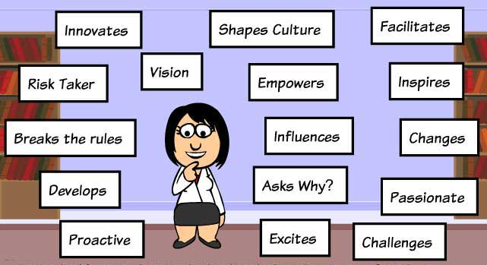
Members who hold managerial roles
MSC pathway
When managers call for support…
“when a situation arises where the member manager requires management support when dealing with a member staff member during a performance or conduct issue that may present a conflict of interest for NZNO industrial staff. Normally the member manager is declined NZNO support and advised to seek employer support. This is not always avalaible hence the need for support from NZNO.”
Notes:
The pathway defines NM support … but like I said quite often it is not as straight forward and requires Hilary and I to hear the story from the NM to see what they have done to date, what the response or outcome has been and who else needs to support them. It also depends very much on the size of the provider and infrastructural support – while we get calls from across the sector, it is the smaller DHB’s or NGO’s that don’t have as much HR resource. Some NM are in small practices that have quite limited support. What I have observed however is that mostly they have excellent CE or GM support and have access to legal support. Its important HR policies are in place so the NM can follow good process when managing difficult performance issues or complaints.

Slide 9

Looking back over the year…
Reasons for calls:
Staff performance issues
Complaints
Bullying behaviours
Issues with their manager
Expectations from managers/HR
Managing team
Some stats:
Jan – Oct 2017 – 20 calls
(plus follow up)
Across sector
Notes:
The main reasons for calls are summarised on the slide. They are mostly situations where the manager is needing advice about how to manage a staff member’s behaviour or practice or they are checking that what they have done is reasonable. They often aren’t well supported by HR and feel isolated, it can be a lonely role. We sometimes coach the NM in how to manage or behave in a difficult situation or when working with challenging staff – to remain professional and keep information confidential even though staff may share information with others that is not always accurate. It can be quite distressing for the NM and can rightly feel aggrieved – we find a listening ear and reassurance in these situations is important. Also enforcement of what they are doing and encouragement that if they continue to manage the process in a fair and reasonable manager they will get good results and staff will observe that.
What is also clear is the NM wants the right thing for the staff member and will often seek advice on how to support the staff member more. I have been quite impressed with the NM’s I have talked with how committed they are to ensuring they manage the process well and the welfare of their staff and service.

Slide 10

MNPS and APSM response
Listen – understand issue, context and what has happened to date
Often multitude of issues
Experience in role
HR resource
Manager relationships – staff, manager, HR
Advise
Coach
Refer
Document
Follow up
Notes:
When we get a referral for a NM on the pathway we will contact them by email asap and set up a phone call. I start by listening to what the issues are, what they have done to date, what processes they have followed, what's been the response to this but also how they finding the process. I also check to see what support they have from their manager or HR. Sometimes I have advised they seek EAP or further support –especially if they have a complaint against them or they are feeling bullied.
Some NM seek more understanding of NZNO’s process when an IO is supporting a member and what expectations they can have of this process and their role in it. We will advsie if they need to get more support themselves. We will also advise if the NM needs more support with difficult conversations and we get a PNA involved at the local level but mostly it is being available on the phone for the manager, listening, providing advice and any resources that might be helpful.

Slide 11
What do middle managers need?
Training in technical aspects of their role
Supervision and peer support
More time on the job – meetings, clearer expectations, better information, office days
Contribution to patient care and outcomes recognised
More assistance, better IT, budget support, better decision making processes
More empowerment and autonomy
Less interference
Notes:
It is important NM and leaders are supported into new roles, particularly when they are required to perform certain tasks (like understanding a budget) or being responsible for managing a team and all the intricacies that beings with it. It will depend very much on the structure and support of your individual organisations – some will have quite structured and formal leadership programme and others will be left to figure it out themselves. The capabilities and leadership style of your direct manager will greatly influence how you succeed in your role.

Slide 12
Being in control…
“organisations are very messy – an uncontrolled combination of relationships”
I can see the difference between what I can control and what I can’t control
I should be in control of everything
I can’t control everything – in fact circumstances are against me…
Notes:
You will start to get a sense of how you function and how much information you need to do your job. You will recognise managers who want to control everything and others who will work with high trust and let you get on with things and seek help when you need it. Too much or too little can be uncomfortable.
It is helpful to see what is in your control and what you cannot control – that will help you understand who you need to work with or influence to get something done otherwise it can be a frustrating experience trying to do it all by yourself or find yourself in a conflict situation.

Slide 13
Recommendations
Succession planning – grow leaders
Opportunities
Nurturing emerging leaders
Coaches, role models and mentors
Willing to learn
Build resilience – support complex decision-making
Organisational support – does the environment support decision-making?
Formal programmes
Notes:
We strongly recommend nurse manager and leadership roles have an orientation programme covering core competencies that includes leadership and management skills and a good mentor something we can provide through the managers pathway but its important organisations have this support for new managers.

Slide 14
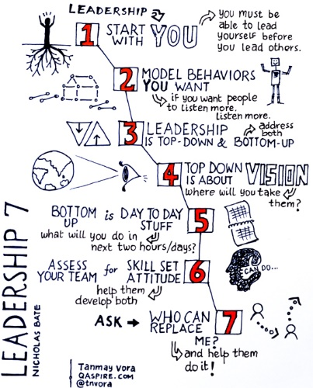
A few words on Leadership…..
(Diana Jones – Leadership Material – 2017)
“the demise of the rational leader…”
“dealing with people, relationships and behaviour comes with the territory…”
“simplify the complexity of organisational relationships and behaviour…”
“personal influence..”
“impact of behaviour…disruptive to productive”
“addressing workplace issues…”
“bringing awareness..”
Notes:
There is so much information and theory on leadership. I have done a lot of work with Diana Jones – I recommend her book. What I like about her style and coaching is that she focuses on relationships – on language and communication and moves away from trying to overanalyse and overwork issues that you may not ever understand but waste a lot of time and energy on.
You cannot avoid dealing with people in the workplace and a lot of time is taken up with behaviour that disrupts others. It is hard and often challenging work. However people dilemmas are a leaders most time consuming work.
Many people are often not aware of the impact of their behaviour on others, sometimes just asking the question, “are you aware you….” they may never have heard that before or know that is how they are perceived. This is also about your own behaviour and having an awareness of how others perceive you.
Diana debunks the myth of the rational leader, that being logical and rational is the only route to leadership. Focusing on technical skills wont always help essential conversations or difficult situations. While its important to know your strengths its also important to know how you impact negatively on others. If you understand how you are perceived both positively and negatively then you can focus on how you effectively influence and work with others with confidence. If you just focus on how you are perceived negatively you will down play your strengths, lack confidence and get stressed. However if you don’t care how you are perceived then you will come across as hard on people and uncaring. So its important to know your blind spots but work with them to get things done by how you can influence.
Understanding why people behave in certain ways is unimportant, its more important how you respond. Be aware of your emotional response – positive working experiences are essential for achieving results but we all know we sometimes come away from a meeting or a conversation where you are thinking. “that did not go well.” often we default to a behaviour under pressure (going silent, taking control, over talking, giving up..) so it is helpful to do some work to understand what behaviours you default to so that you recognise what others are seeing.
So leaders flourish when they know themselves better accepting their strengths and weaknesses and are open to learning – also you will become more conscious why you are in a leadership role and what you can influence and contribute to that gets results.

Slide 15
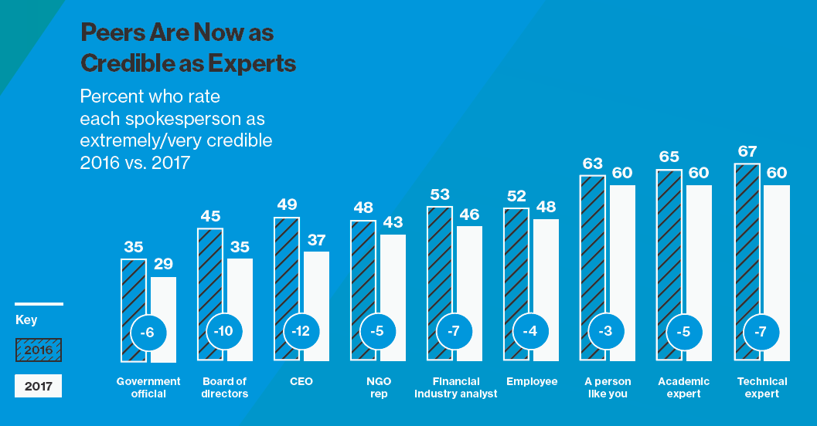
The implosion of trust
Source: http://www.edelman.com/news/2017-edelman-trust-barometer-reveals-global-implosion /

Slide 16
NZNO Strategy for Nursing
Model of care
Manaakitanga
Equity
Tika
Leadership
Rangatiratanga
Our Community
Whanaungatanga
Nursing workforce
DISPARITY
CRITICAL MASS
WASTE
Notes:
Over the last year we have been developing strategy for nursing that is due to come out for consultation in the next month. This is the conceptual model that will provide the foundation for the strategy. There are 3 strategic actions, disparity, critical mass and waste that .. It is a key tool that will resolve structural and fiscal barriers that impede nursing effectiveness but also support the profession and invest in nursing leadership.

Slide 17
“What would Florence do? A guide for the New Nurse Manager”
Sue Johnson, ANA

Slide 18
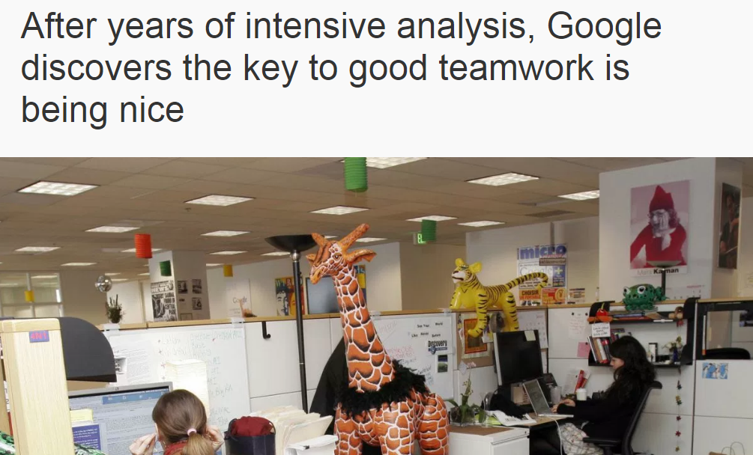
|@HorizonsNHS
Project Aristotle: http://qz.com/625870/after-years-of-intensive-analysis-google-discovers-the-key-to-good-teamwork-is-being-nice/

