Slide 1
Donor Liaison Coordinator
Tony Stephens

Slide 2
New Zealand 2013
4156 patients receiving RRT (936pmp)
0.09% of population
546 new patients added
Dialysis dependent 2584
Functioning transplants 1572
Source : ANZDATA 2014 Report

Slide 3
Wellington
232 dialysis patients
59 patients on transplant waiting list

Slide 4
This 0.09% of the population costs 1-2% of the healthcare budget (www.kidneys.co.nz/.../file/kidney_health_nz_manifesto_july_2014.pdf)
Huge impact on the patient and their family
On average, only one in three people are alive five years after starting dialysis
(Ministry of Health and Kidney Health New Zealand. 2013. Living with Kidney Disease: A comprehensive guide for coping with chronic kidney disease. Second edition. Wellington: Ministry of Health)

Slide 5
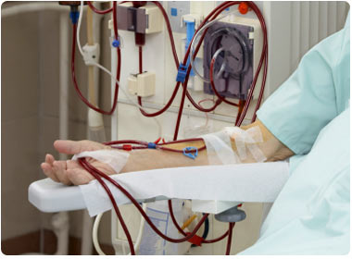
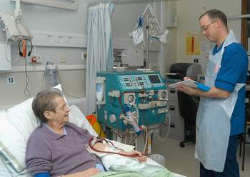
Haemodialysis 3 sessions per week of 4-5 hours

Slide 6
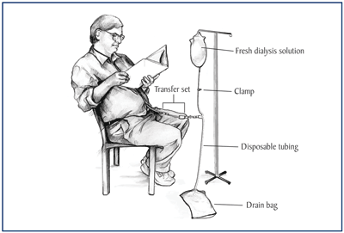
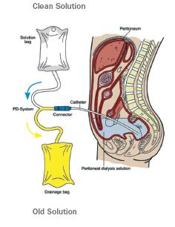
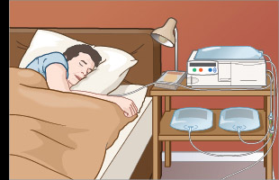
Peritoneal Dialysis
3-4 exchanges per day 30-40 minutes each or
8-9 hours every night

Slide 7
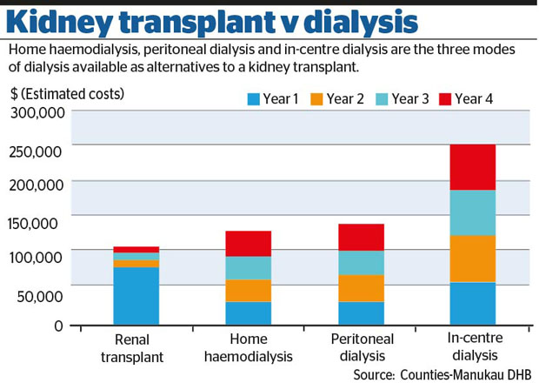
Relative Costs

Slide 8
Transplants in NZ
 | 2010 | 2011 | 2012 | 2013 | 2014 | 2015
Deceased Donors | 50 | 61 | 54 | 55 | 67 | 73
Live Donors | 60 | 57 | 54 | 58 | 72 | 74
Source : Organ Donation New Zealand 2015
About 640 people on kidney transplant waiting list in NZ
Wellington
2014 : 32 transplants
2015 : 30 transplants
2016 : 6 so far
Notes:
Show the graphs of the survival rates of deceased and living donors

Slide 9
Suitable Recipients
Contra-indications : malignancy, chronic infection, other major organ disease
BMI up to 40 depending on body shape (ideally <35)
40% ejection fraction
Malignancy clear for 2-5 years depending on cancer
Hep B and C : possible but other treatments needed
Standard criteria in Australia and New Zealand
Patients should have 80% chance of living at least 5 years after transplant

Slide 10
Transplant Options
Deceased
Living
ABO incompatible
Kidney Exchange

Slide 11
Deceased Donors
From a person who has died in ICU
Donor blood cross-matched with 15 highest ranking blood group matches on national list
Best match is ranked first then points system according to length of wait and time on dialysis
Ideally transplanted <24 hours after retrieval

Slide 12
Live Kidney Donation
Suitable donors :
People over 18 years
In good health with 2 healthy kidneys
Not suitable :
Diabetes, cancer, hypertension, very overweight (BMI >35), serious mental health conditions
Very rigorous testing of donor to ensure safety and minimise potential long-term issues

Slide 13
ABO incompatible transplants
Take place at Auckland or Christchurch
Recipient has plasma-pharesis prior and stronger immune-suppression
Kidney Exchange
Increases pool of kidneys to increase chances of transplant
Will be combined with Australia in future

Slide 14
Transplant Kidney Survival
90-95% of transplants working after 1 year
80-85% of transplants working after 5 years
Average lifespan is 10 years
Many still working after 20 years

Slide 15
Donor Liaison Coordinator
Government policy to increase number of transplants to 160/yr by 2018/19
Benefits to patients
Benefits to hospitals
Benefits to country

Slide 16
My Role
Educational
Speaking to patients, families, friends
Speaking to community groups to get message to people
Nursing donor clinics (pre-assessing, arranging tests etc)

